Slide 1
Analysis of 2nd pilot experiment in Madrid

Slide 2
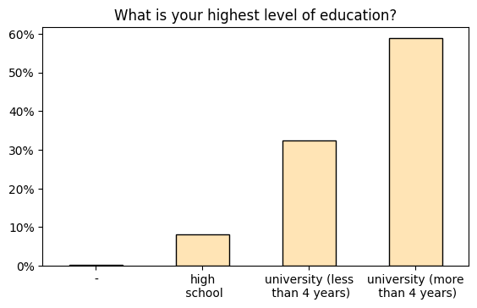
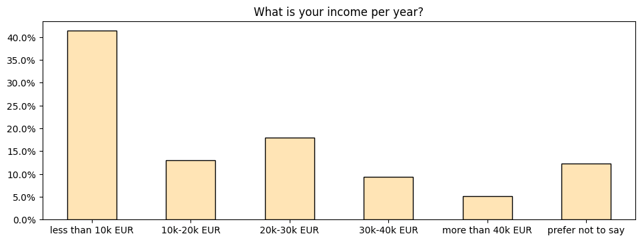

Slide 3
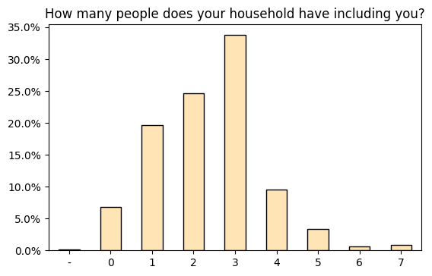
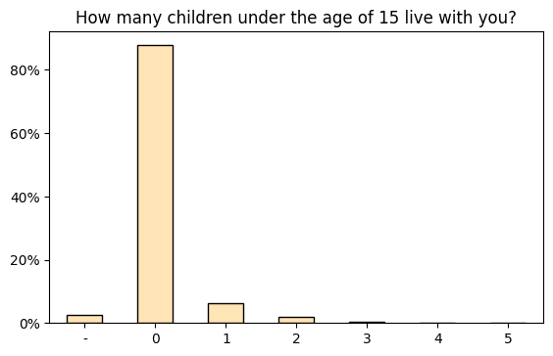

Slide 4
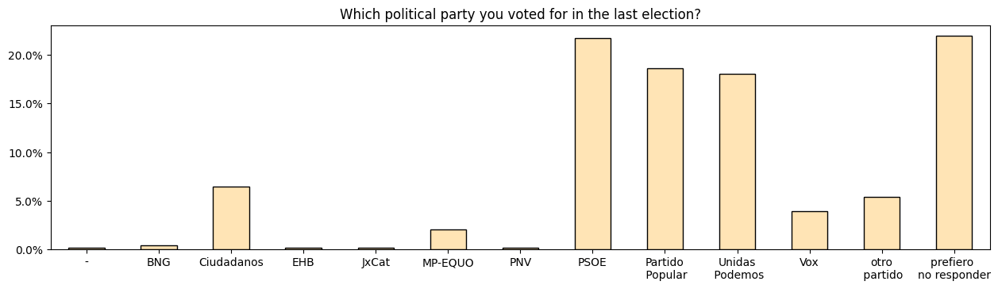

Slide 5
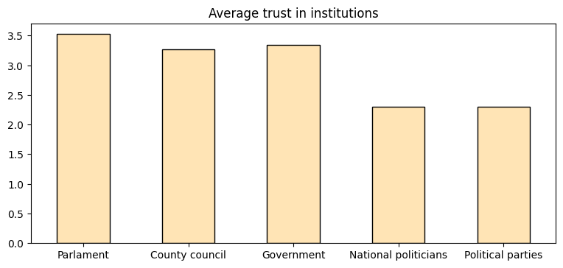
How much do you personally trust the following institutions from 1 to 7, where 1 means ‘No trust at all’ and 7 means ‘Trust compltely’?

Slide 6
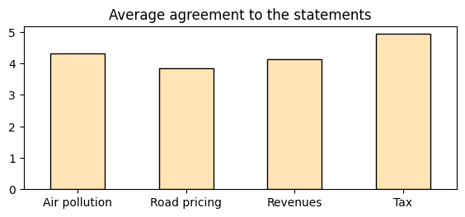
How much do you agree with the following statements from 1 to 7, where 1 means ‘I completely disagree’ and 7 means ‘I completely agree’?
Air pollution derived by cars is one of the major causes of premature death in Europe
The introduction of policies such as road pricing will alleviate congestion problems
Revenues collected through taxes are used to create a well-functioning welfare state and society
Tax revenues should be used to help those who are more in need

Slide 7
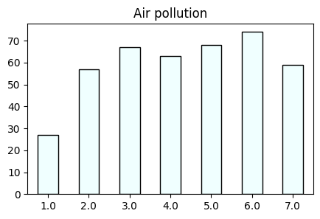
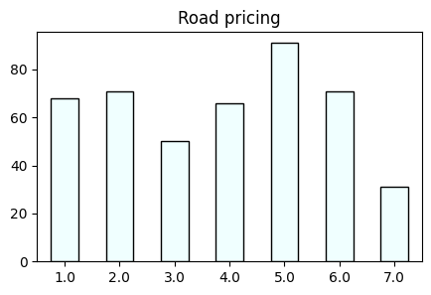
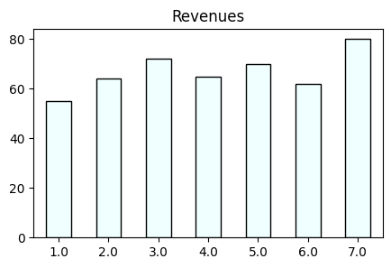
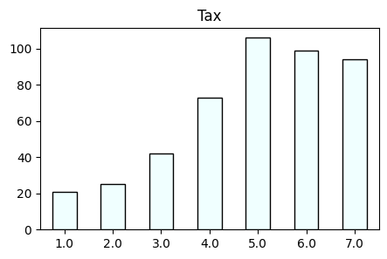

Slide 8
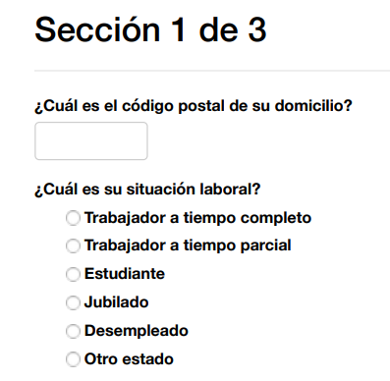
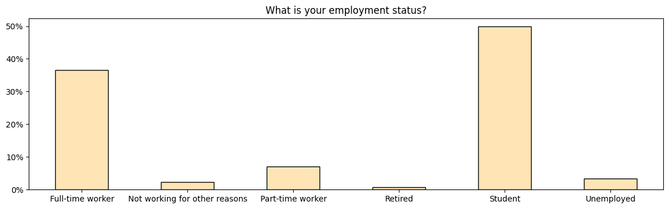

Slide 9
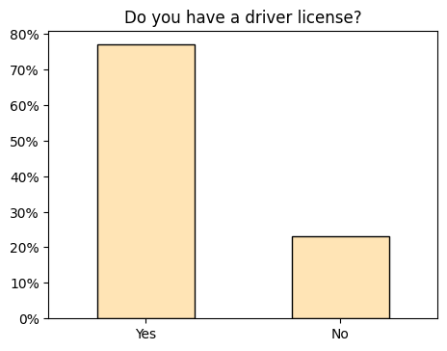
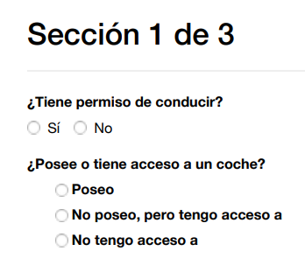
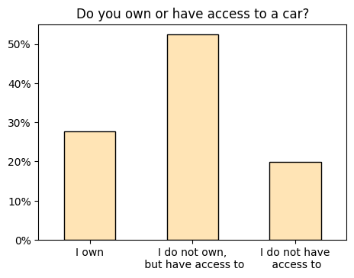

Slide 10
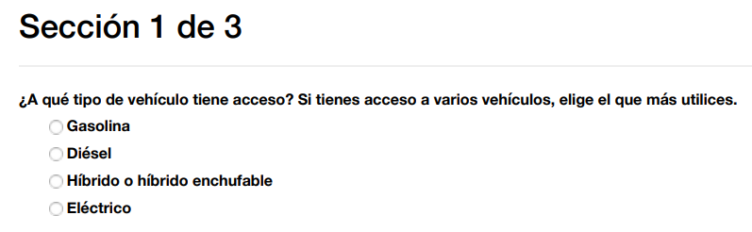
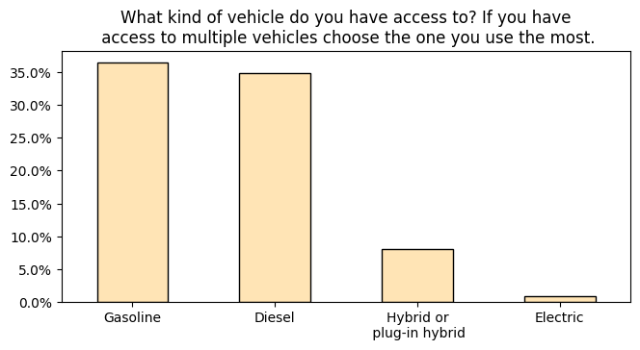
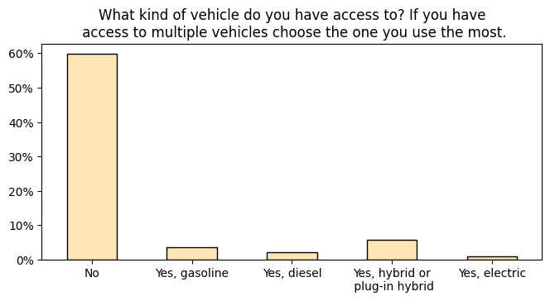

Slide 11
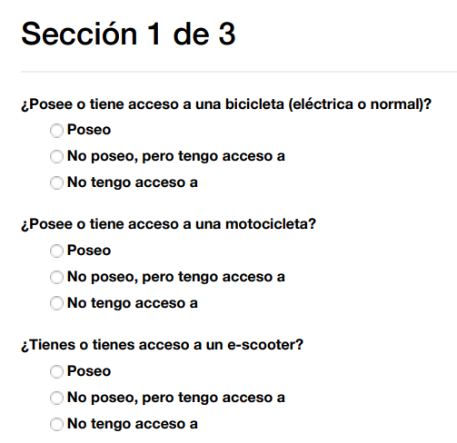
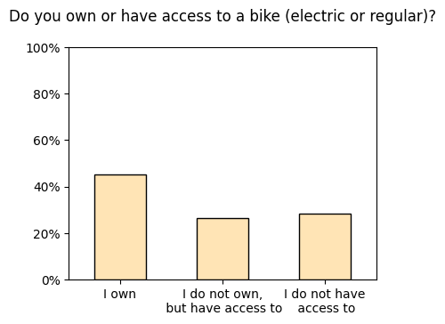
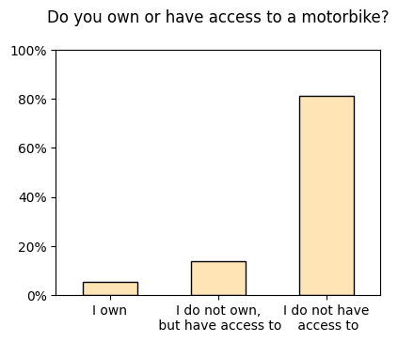
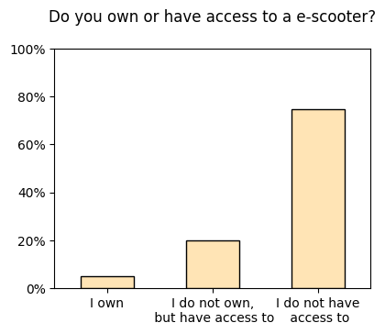

Slide 12
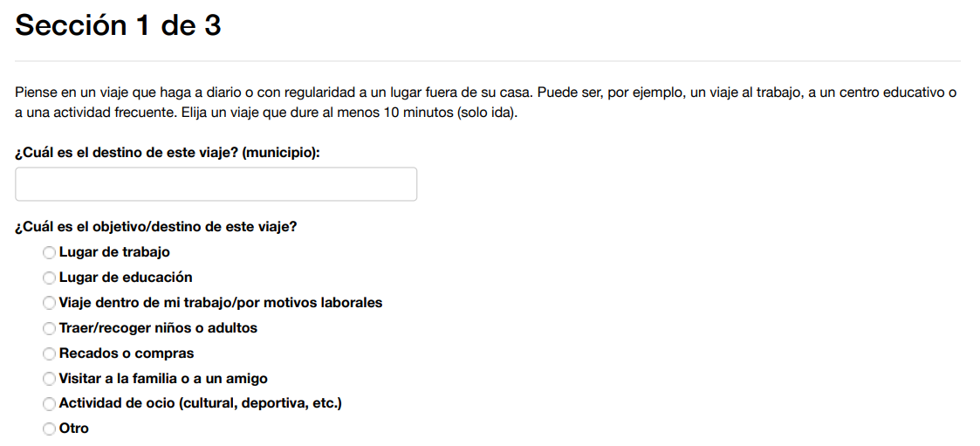
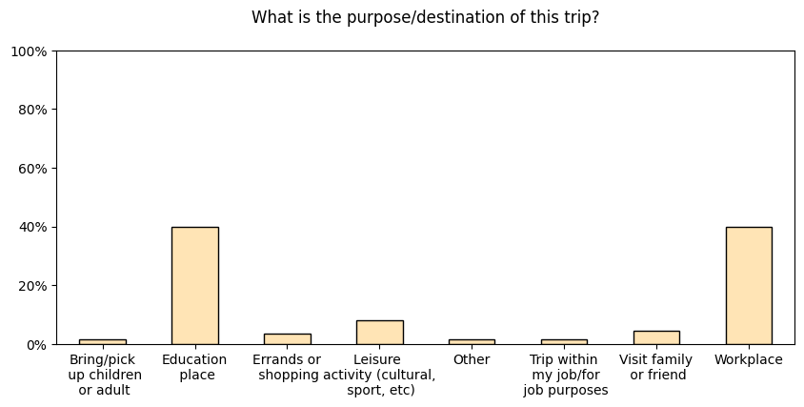
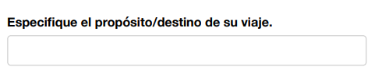

Slide 13
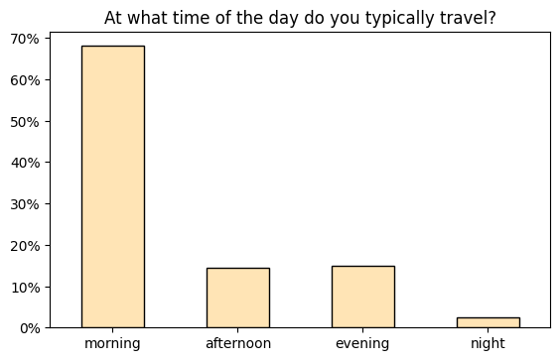
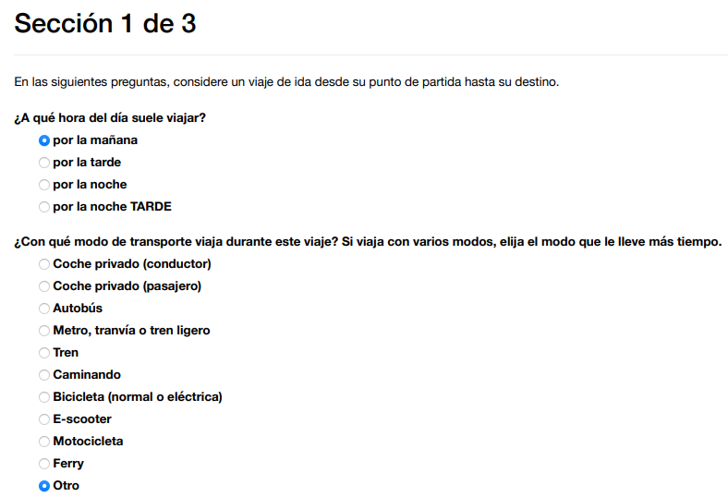
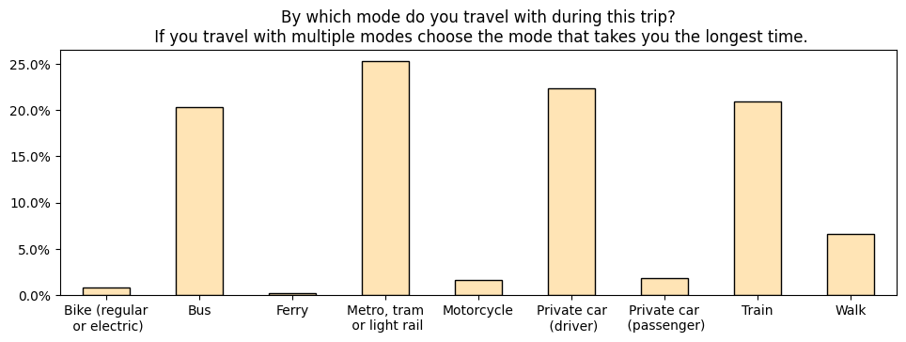
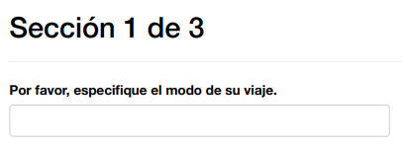
25.87% of the respondents travel by private transport (car or motorbike)

Slide 14
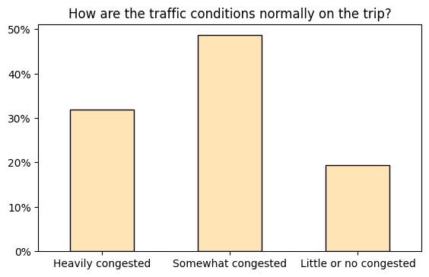
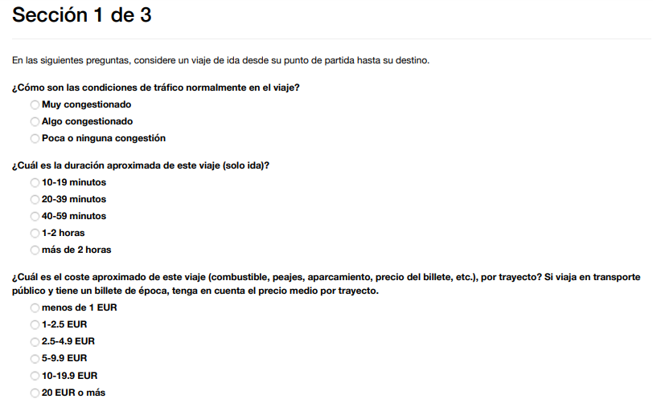
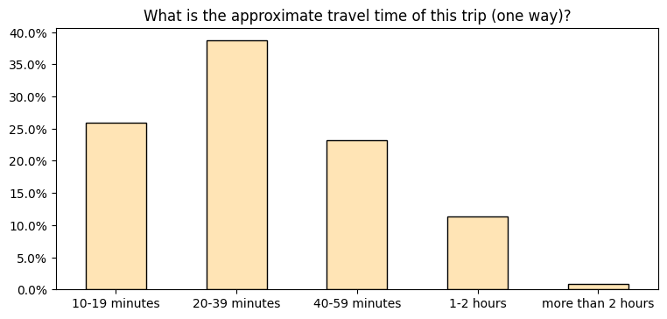

Slide 15
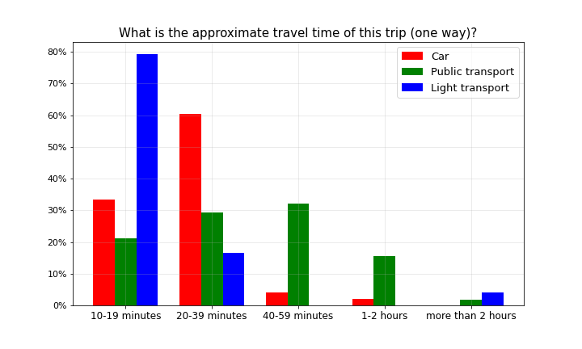
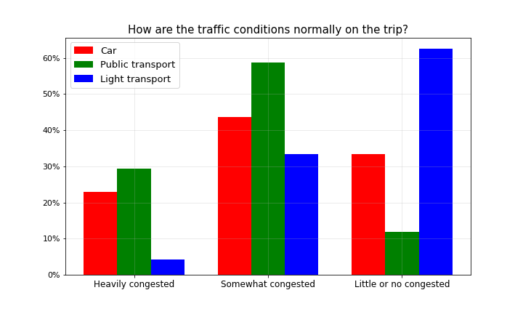
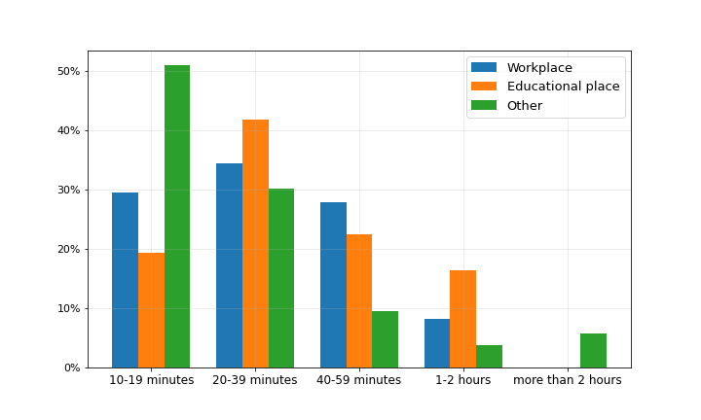

Slide 16
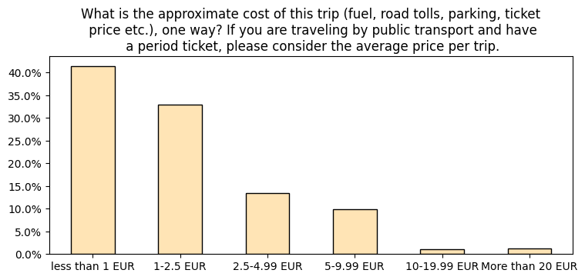

Slide 17
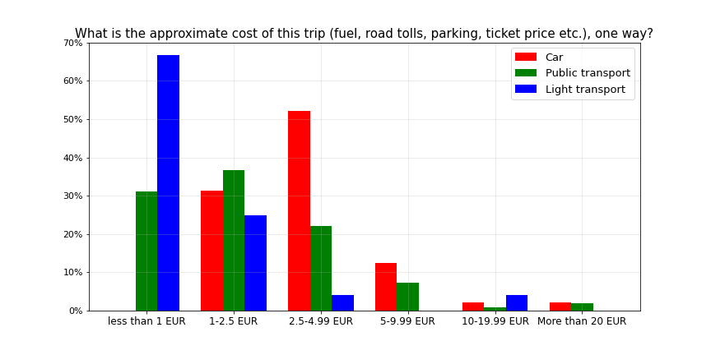

Slide 18
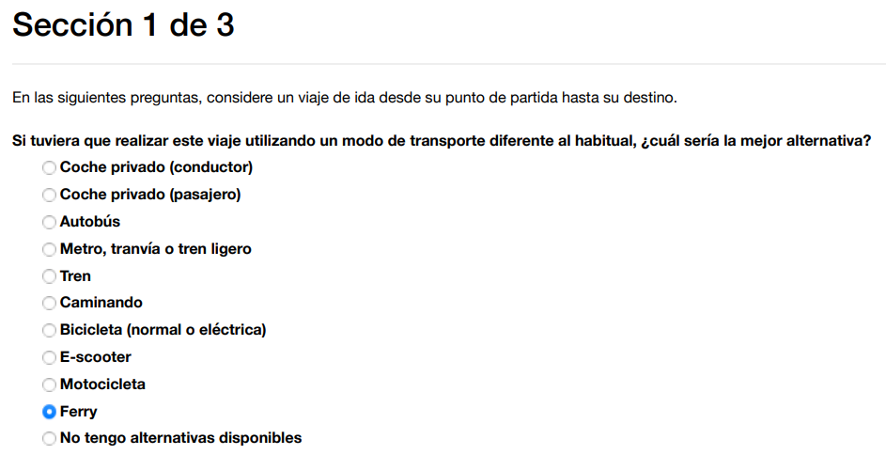
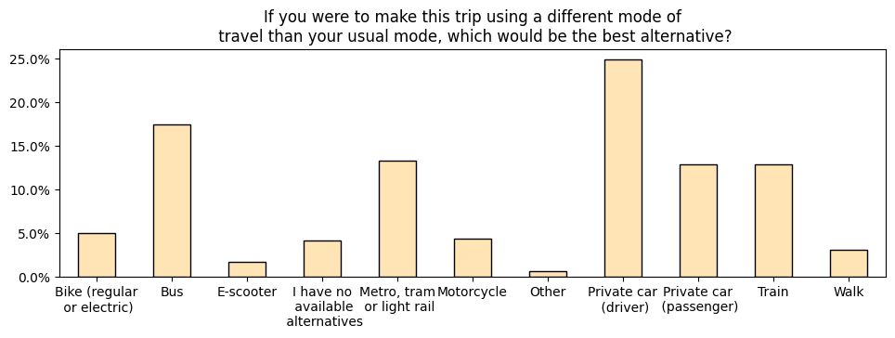
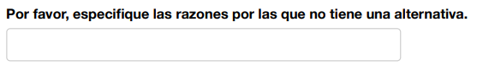

Slide 19
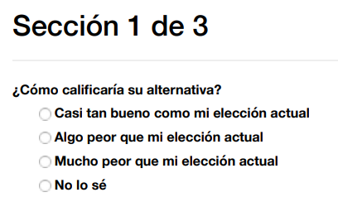
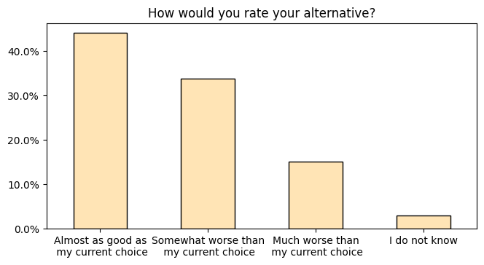

Slide 20
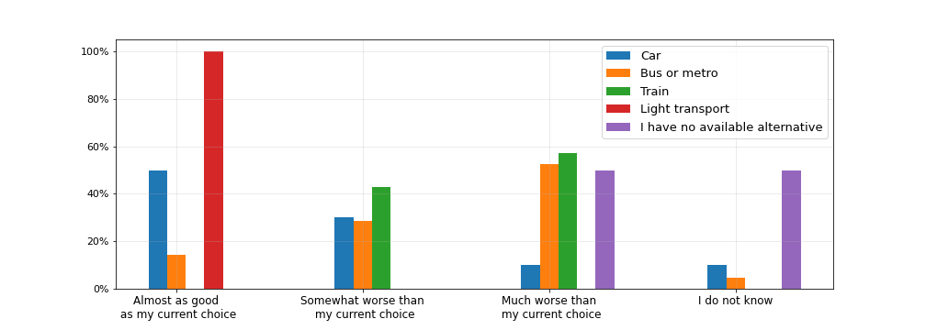
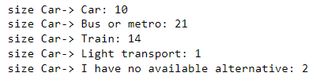
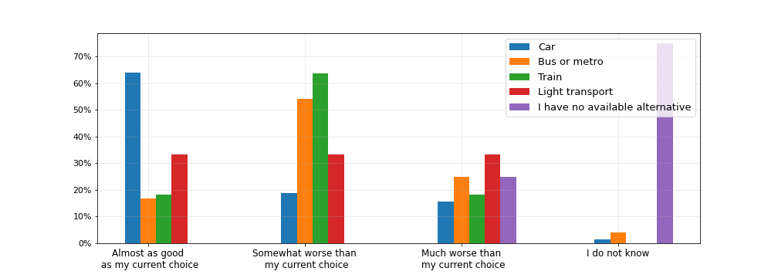
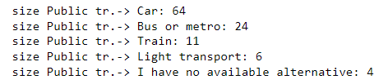
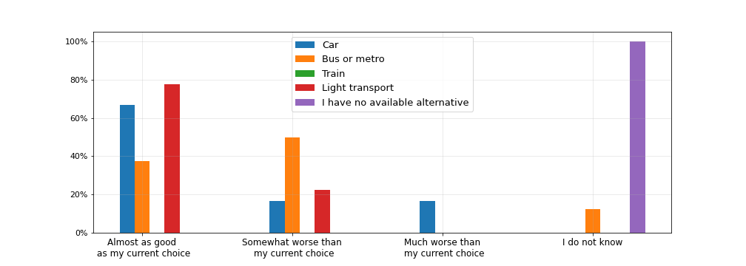
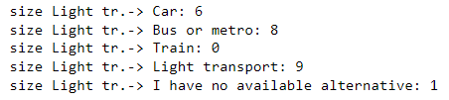
← From “Car”
From “Public transport” →
← From “Light transport”

Slide 21
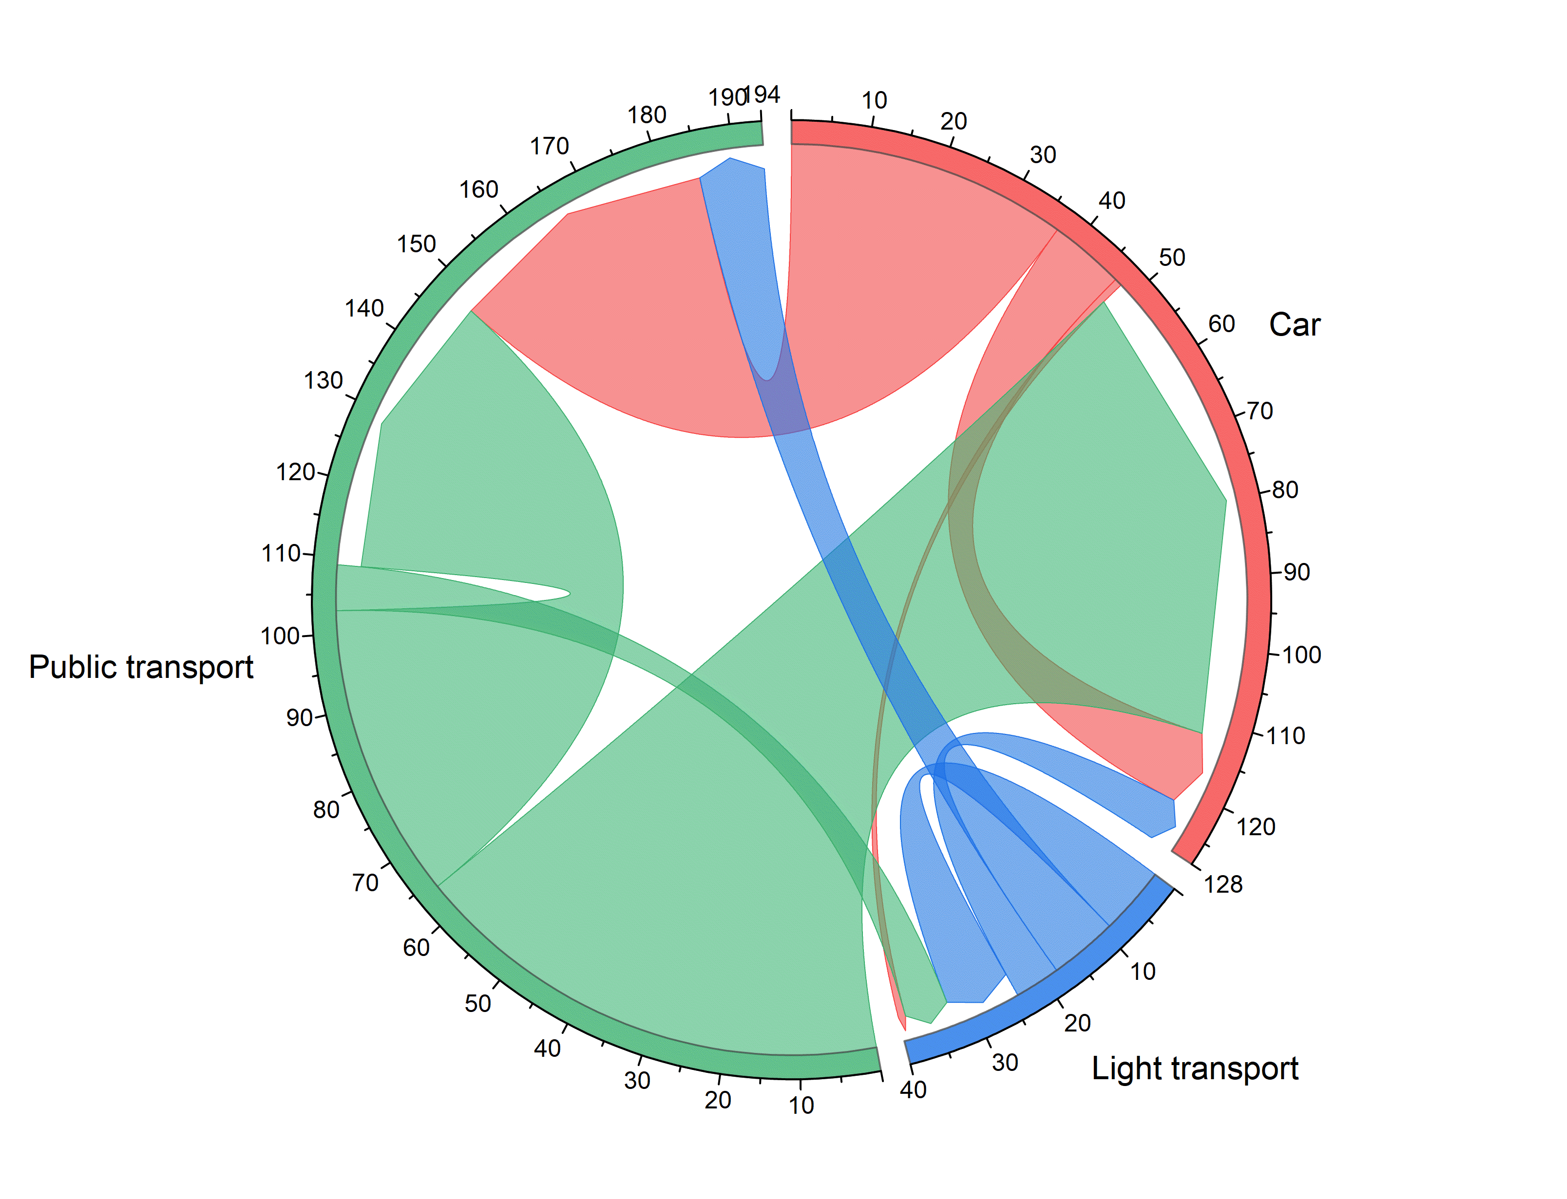
The chord diagram represents the flow between different transport means.
The arrows display the transition between the first alternative (the preferred transport mean) and the second alternative.
We included in the category “Car” the transport modes:
Car (driver)
Car (passenger)
Motorbike
In the category “Light transport” the modes:
Walk
Bike
E-scooter
Other / I have no available alternatives
In the category “Public transport” the modes:
Bus
Metro, tram or light rail
Train
Ferry

Slide 22


Slide 23



Slide 24


Slide 25
Sec. 2 Choice experiment

Slide 26


Slide 27


Slide 28



Slide 29


Slide 30

The money raised from the tax can be used in one of the following ways:
General budget: The government will decide how to use the revenue according to its priorities.
Equal cash transfer: The revenue will be distributed equally among all citizens.
Cash transfer for low-income citizens: Revenues will be returned to low-income citizens.
Road investments: Revenues will be used for road investments and maintenance.
Investments in public transport, walking and cycling: Revenues will be used for investments and improvements in public transport, walking and cycling infrastructure and services.

Slide 31

Each participant was asked to order the different ways of reinvestment from the best (Alternative 1) to the worst (Alternative 5).
The plot shows for each “reinvestment type” the percentages of people which chose it as Alternative 1 (in blue), Alternative 2 (orange), up to Alternative 5 (in purple).
To make an example, 50% of people chose “Investments in public transport, walking and cycling” as Alternative 1, and 30% as Alternative 2.

Slide 32

Treatment 2: Congestion and pollution

Slide 33

Treatment 3: Public services

Slide 34

Treatment 4: Redistribution

Slide 35


These screenshots correspond to a participant who was in the treatment Public services

Slide 36


Slide 37


Slide 38


Slide 39


Slide 40


Slide 45
The interpretation of the exponentiated coefficients is for a single unit change in the predictor variable, the odds will be multiplied by a factor indicated by the exponent of the beta coefficient, given that all other variables are held constant.
In this analysis with all treatments together, the first variable is Price_UR_A with a value of 0.86. This means that if Price_UR_A increases by one unit the odds of choosing option A as preferred policy choice is 86% compared to the status when Price_UR_A did not increase by one unit (so it lowers when the price raises).
Whereas the odds of choosing option B is 108% (so it increases when the price of option A raises).
A similar behaviour is observed for variable Price_UN_A .
On the contrary, if EV_A increases by one unit the odds of choosing option A is 107% and of choosing option B is 95% compared to the status when EV_A did not increase (probabilities of choosing an option with increased discount for electric vehicles increase).

Slide 46
A symmetric effect is observed for the variables describing option B: an increase in Price_UR_B and Price_UN_B lead to a decrease in the probabilities of choosing option B (92%, 93%) , while an increase in EV_B leads to a increase in the probability of choosing B (109%).
Another significative variable (p<0.05) is the categorical variable referring to the revenue alternative "Investments in public transport, walking and cycling". When option A contains this revenue alternative the odds of choosing option A are 153% and of choosing option B are 63%, compared to when this revenue alternative is not there. Symmetrically, when option B contains this revenue alternative the odds of choosing option A are 74% and of choosing option B are 169%, compared to when this revenue alternative is not there.

Slide 47
Sec. 3a Social norms

Slide 48

This particular participant is seeing:
‘Private veichle’ as option A, and
‘Public transport, cycling and walking’ as option B
Empirical Expectation
(EE)
Personal Normative belief
(PNB)
Normative expectation
(NE)

Slide 49

What share (in %) of other participants in the survey do you think have chosen one of the transport modes in A for their daily trip?
Empirical expectations (EE)
Percentage of the expected use of car among participants
Both plots show the distribution relative to the option: car
(the distribution of set A is kept the same, while for set B we computed 100% - their answers)
Participants having car as option A
Participants having car as option B

Slide 50

Empirical expectations (EE)
Percentage of the expected use of car among participants
A: Car
A: Public transport
The actual number of participants using the car (including driver, passenger and motorbike) is 25.9% of all participants
(dashed line in the figure)

Slide 51
In your opinion, what should the ideal percentage of people using transport modes in A for their daily trip be?
Personal Normative belief (PNB)
Percentage of the ideal use of car among participants
Participants having car as option A
Participants having car as option B

Slide 52

Personal Normative belief (PNB)
Percentage of the ideal use of car among participants
A: Car
Mean: 30.98
Std: 21.33
Total: 91
A: Public transport
Mean: 29.09
Std: 20.83
Total: 90
The green dashed line represents the median of the PNB distribution among participants in the group
“Public transport” → 20%
The orange dashed line represents the median of the PNB distribution among participants in the group
“Car” → 25%

Slide 53
What share (in %) of other participants in the survey do you think have mostly chosen option A (answered more than 50%) in the previous question?
Normative expectations (NE)
Percentage of the expected ideal use of car among participants
Participants having car as option A
Participants having car as option B

Slide 54

Normative expectations (NE)
Percentage of the expected ideal use of car among participants
Personal Normative belief (PNB)
A: Car
Mean: 37.65
Std: 29.53
Total: 91
A: Public transport
Mean: 31.40
Std: 28.04
Total: 90
The dashed line (in the fig. on the left) represents the actual number of other participants who have mostly chosen option A (answered more than 50%) in the previous question, which is 17.12% of all participants, calculated by computing the area under the probability density averaged for the two groups (see fig. on the right).

Slide 55



Distribution of the use of public transport
Distribution of the use of car (driver, passenger, motorbike)
Total : 48 people
Total : 133 people

Slide 56
Social norm strenght definition and measurement
We calculate the norm strength in the following way:
The consistency measures how far are the participants’ expectations from one to another.
The accuracy measures how much participants’ expectations (both empirical and normative) “forecast” what the others will do or think that is appropriate to do.
The specificity measures whether the individual’s empirical and normative expectations are close to the group average empirical and normative expectations.

Slide 57


Consistency

Slide 58


Accuracy

Slide 59


Specificity

Slide 60


Norm strength

Slide 61


Even if you answered that you do not have access to a car, imagine that you have it for your daily commute

Slide 62


Imagine that most of the people answering this survey say they use option A to “go to work” and most of them think that other people should also use option A
Scenario HH (High EE, High NE):
Both plots show the distribution relative to the option: car
(the distribution of set A is kept the same, while for set B we computed 100% - their answers)
Participants having car as option A
Participants having car as option B

Slide 63

Scenario HH (High EE, High NE):
A: Car
Mean: 43.63
Std: 35.21
Total: 91
A: Public transport
Mean: 32.66
Std: 29.18
Total: 90

Slide 64
Scenario HL (High EE, Low NE):
Imagine that most of the people answering this survey say they use option A to “go to work” and few of them think that other people should use option A
Participants having car as option A
Participants having car as option B

Slide 65

Scenario HL (High EE, Low NE):
A: Car
Mean: 40.99
Std: 33.20
Total: 91
A: Public transport
Mean: 30.38
Std: 28.04
Total: 90

Slide 66
Scenario LH (Low EE, High NE):
Imagine that few of the people answering this survey say they use option A to “go to work” and most of them think that other people should use option A
Participants having car as option A
Participants having car as option B

Slide 67

Scenario LH (Low EE, High NE):
A: Car
Mean: 40.90
Std: 32.98
Total: 91
A: Public transport
Mean: 33.01
Std: 29.08
Total: 90

Slide 68
Scenario LL (Low EE, Low NE):
Imagine that few of the people answering this survey say they use option A to “go to work” and few of them think that other people should use option A
Participants having car as option A
Participants having car as option B

Slide 69

Scenario LL (Low EE, Low NE):
A: Car
Mean: 42.75
Std: 35.23
Total: 91
A: Public transport
Mean: 29.33
Std: 27.90
Total: 90

Slide 70
HH
HL
LH
LL

Slide 71

Conditional choice per treatment
We plot the average of the answers of the participants in each question (conditional choice).

Slide 72

Analysis of behavioral typology
The four conditional choices can be summarized into two measures of responsiveness to empirical and normative expectations: Empirical Expectation Influence (EEI), which represents subjects’ sensitivity to empirical expectations, and Normative Expectation Influence (NEI), which represents subjects’ sensitivity to normative expectations.

Slide 73
Sec. 3b Socio-demographics

Slide 74




Slide 77


Slide 78

How much do you personally trust the following institutions from 1 to 7, where 1 means ‘No trust at all’ and 7 means ‘Trust compltely’ ?

Slide 79


Slide 80


Slide 81

How much do you agree with the following statements from 1 to 7, where 1 means ‘I completely disagree’ and 7 means ‘I completely agree’?

Slide 82


How much do you agree with the following statements from 1 to 7,
where 1 means ‘I completely disagree’ and 7 means ‘I completely agree’?
Population in each category:
No information: 42 people
Congestion and pollution: 40 people
Public services: 48 people
Redistribution: 51 people

Slide 83


Slide 84


Slide 85


Slide 86


